Slide 1
Image Classification
Fruits 360 Dataset
Tasfiq Ahmed and Varun Saini

Slide 2
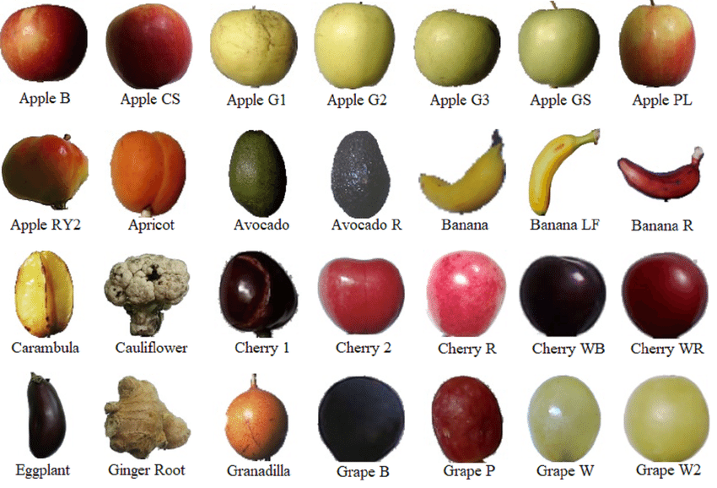

Slide 3
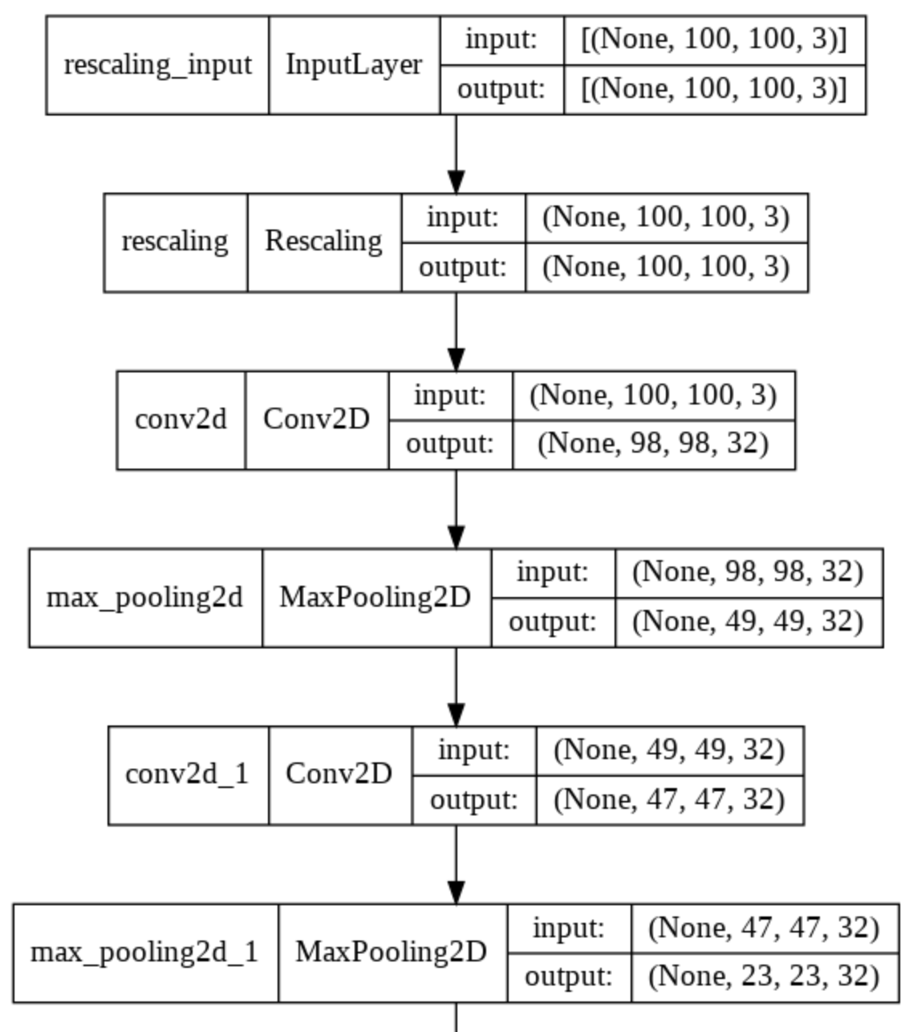
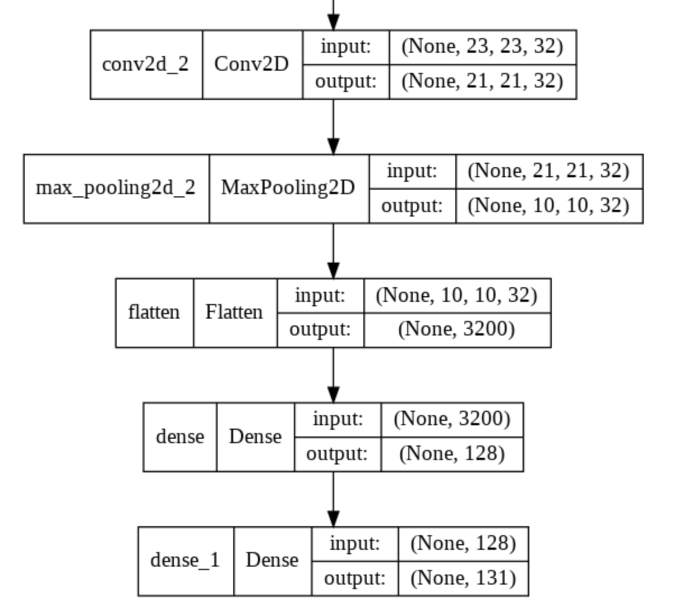

Slide 4
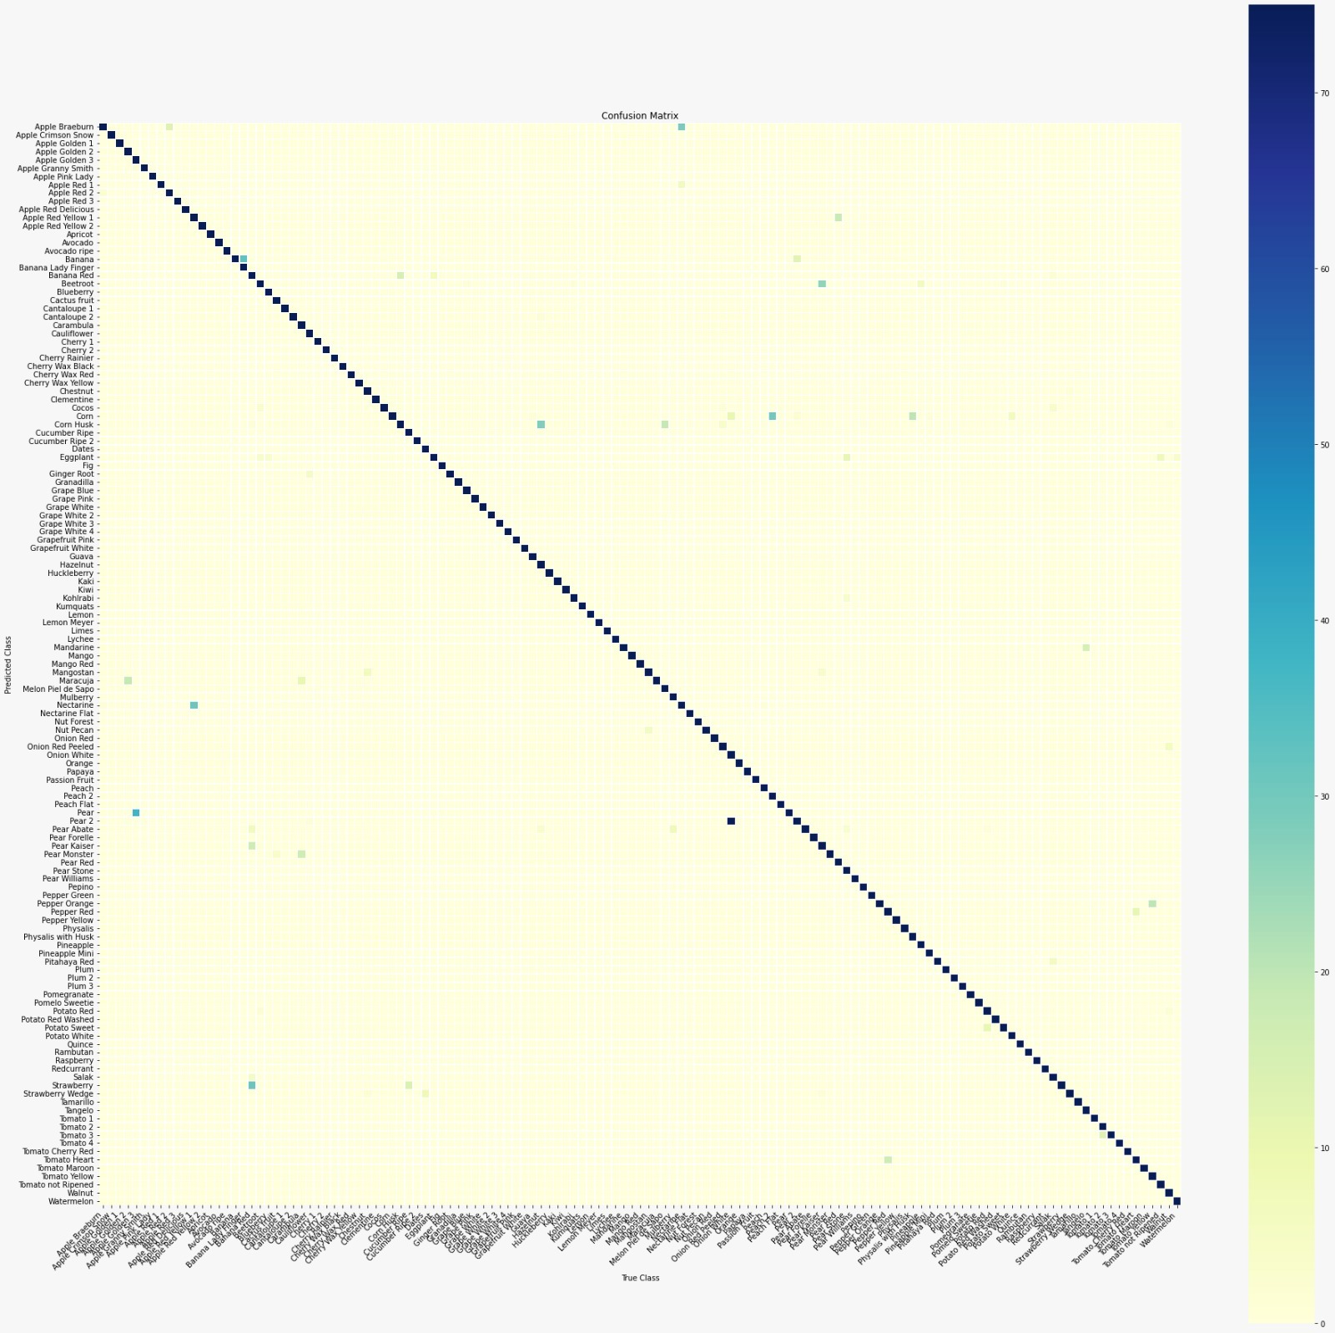
Our convolutional neural network
Accuracy: 96.6%
Precision : 96.8%
Recall: 96.4%
F1: 96.3%

Slide 5
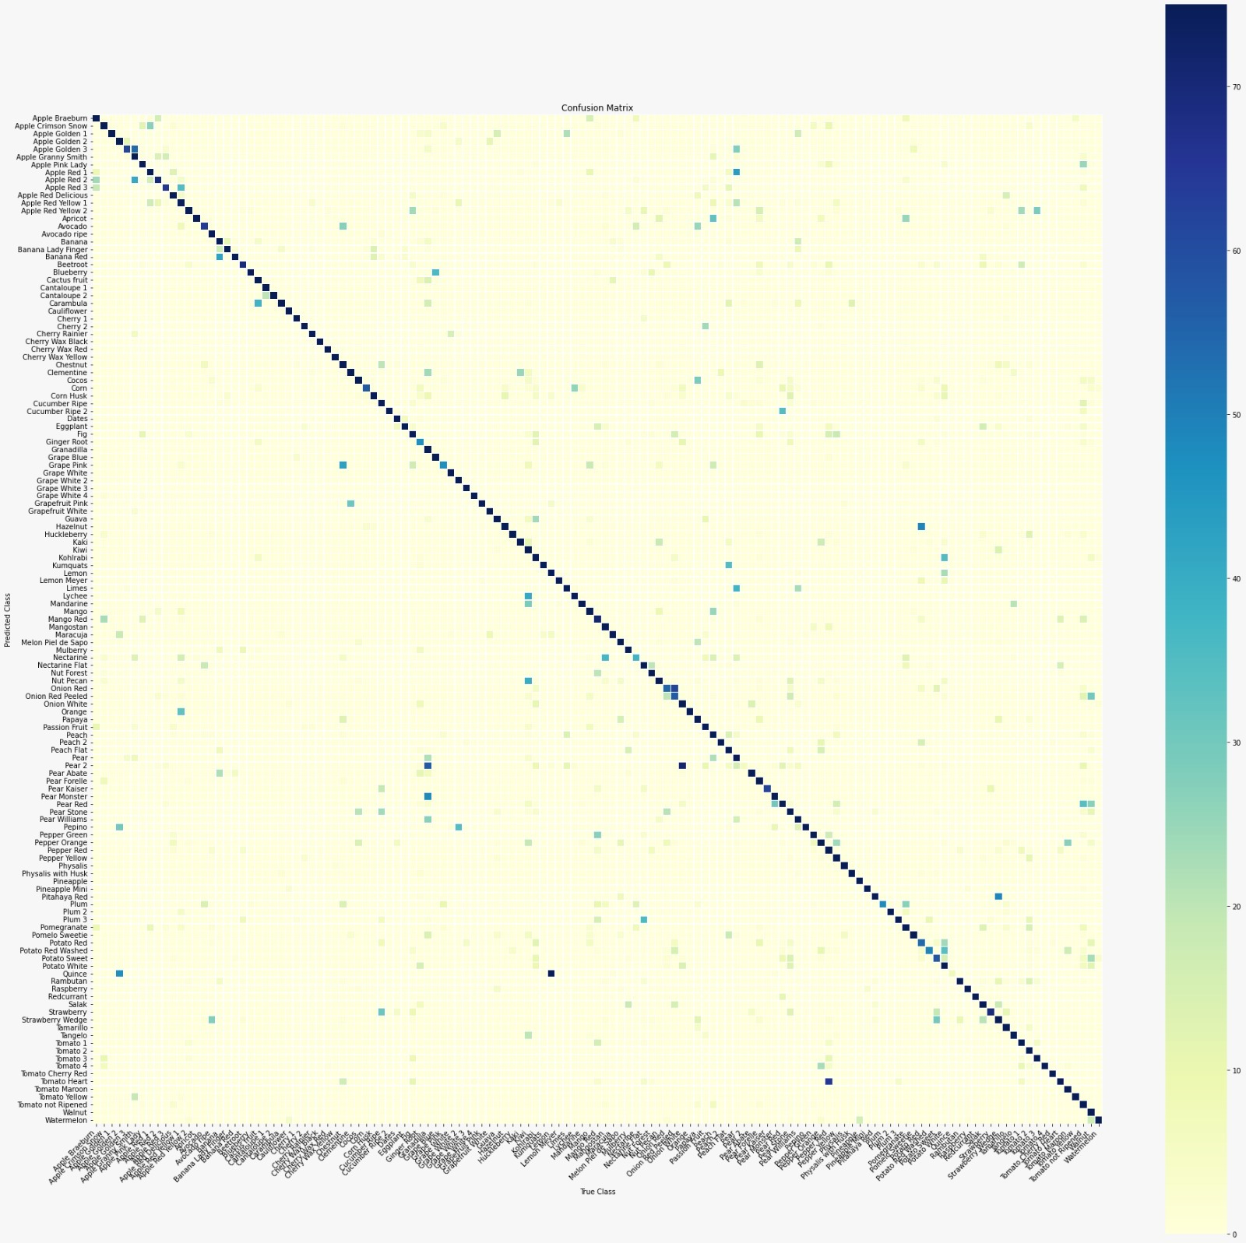
Inception v3
+ 2 trained dense layers
Accuracy: 70.6%
Precision : 74.3%
Recall: 70.0%
F1: 69.7%

Slide 6
Conclusions
Model did well with images from the dataset, but failed to successfully identify handpicked images
Could be attributed to the specific formatting procedure in the dataset
Best CNN unable to generalize well
Performance of the transfer learning model
Not enough data for transfer learning model to be successful
Broader model overall, but accurately predicting classes for images in this dataset requires learning specific patterns
Trade-off between overall robustness/generalizability and accuracy specifically on the Fruits 360 dataset

